Slide 1


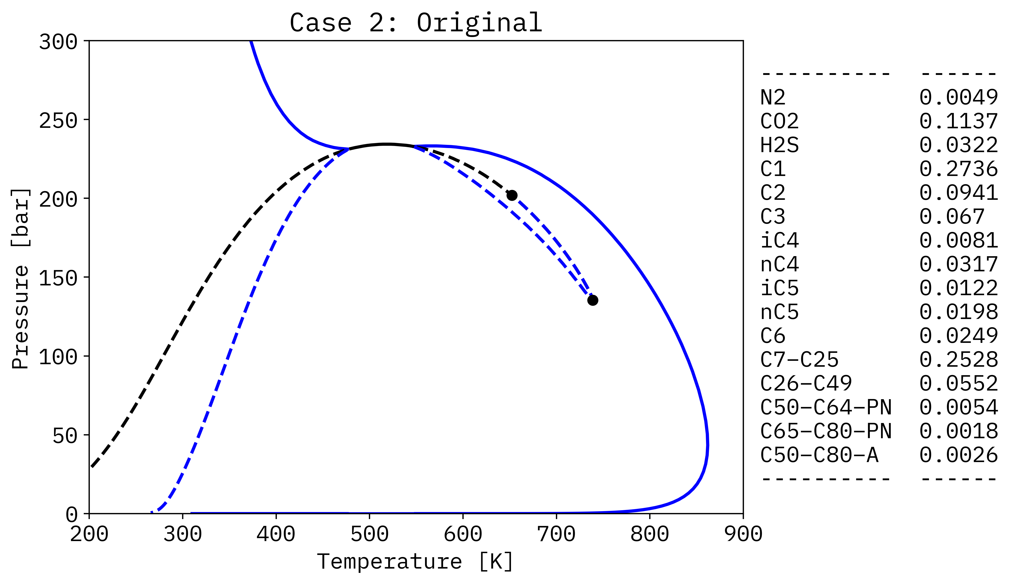
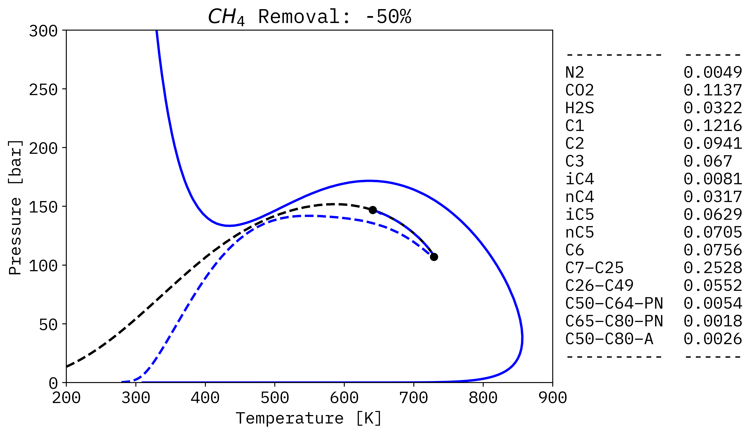
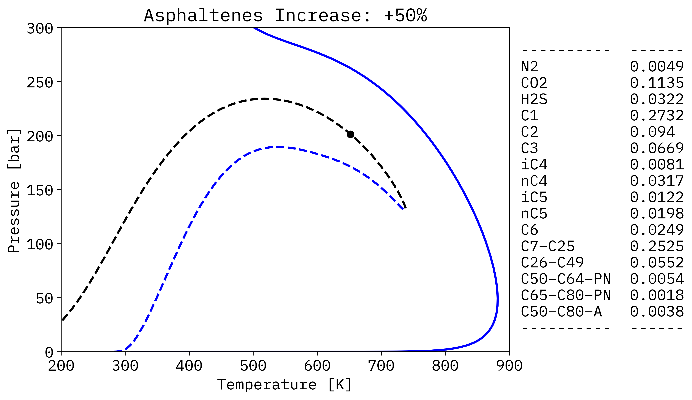
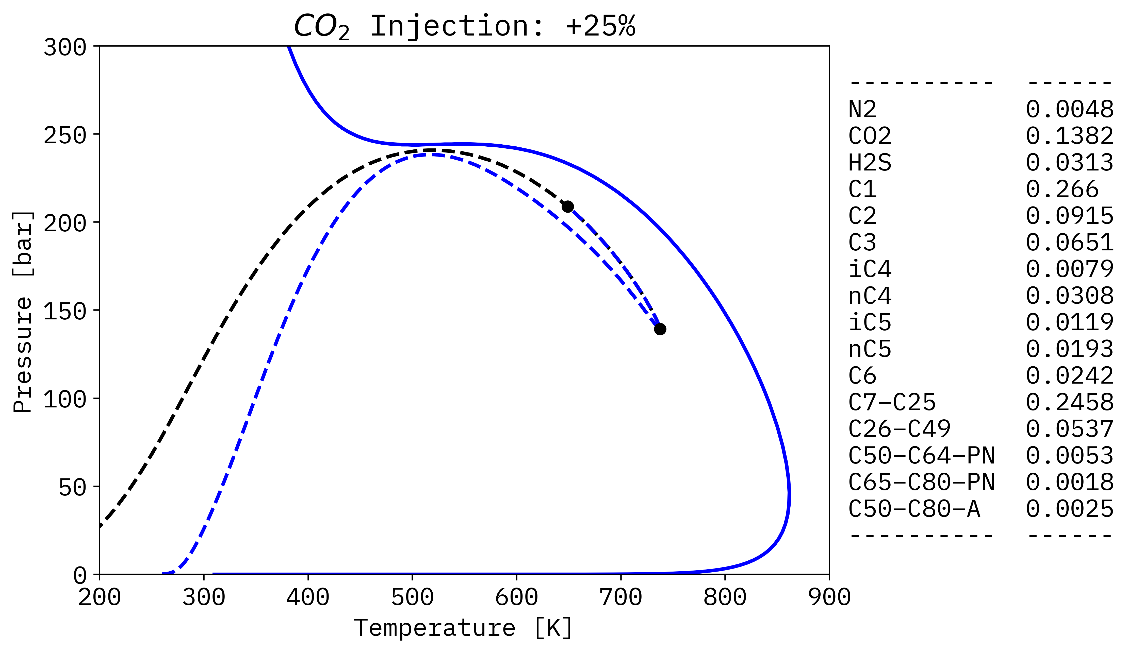
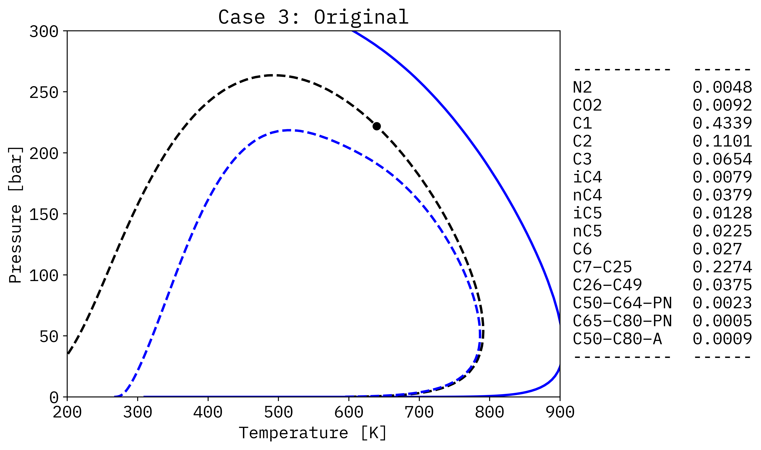
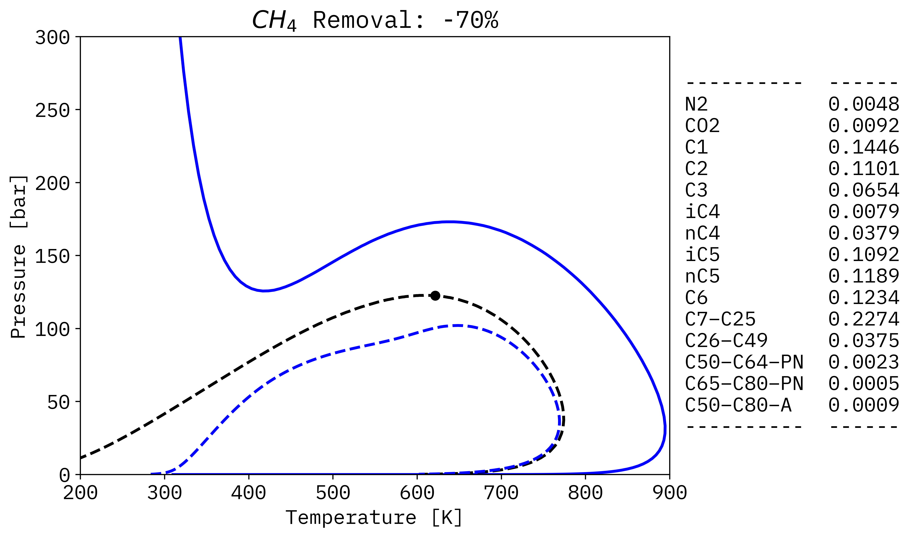
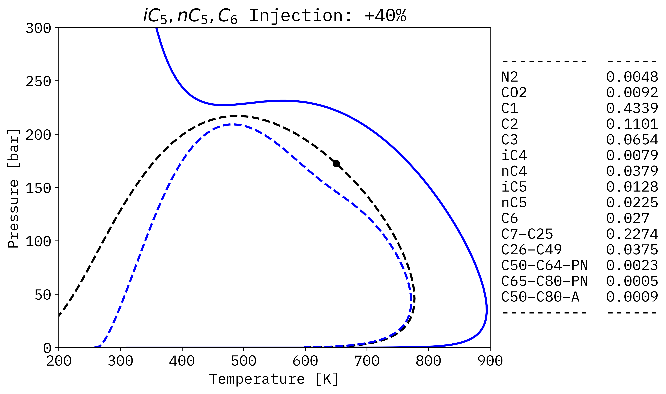
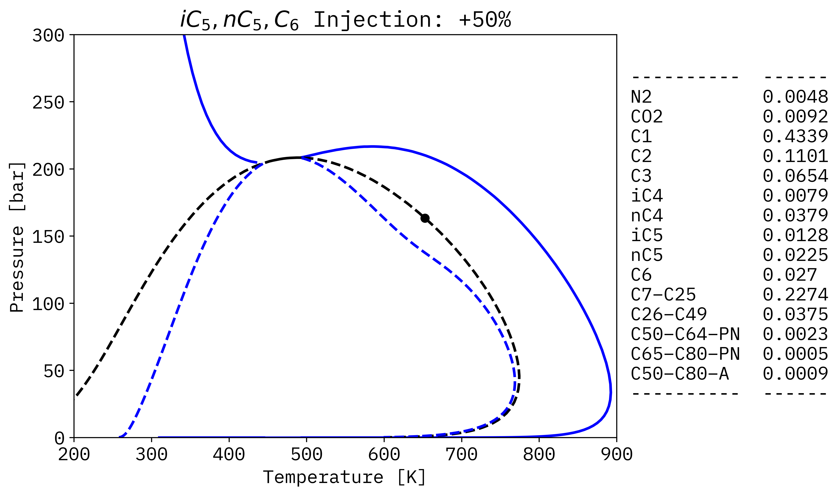


















Phase Envelopes for reservoir fluids with Asphaltene onset lines:
Finding topology transitions based on compositional changes.
Federico E. Benelli¹ , Gerardo O. Pisoni¹ , and Martin Cismondi^{*†1}
¹Instituto de Investigación y Desarrollo en Ingeniería de Procesos y Química Aplicada (IPQA), Facultad de Cs. Exactas Físicas y Nat., Universidad Nacional de Córdoba (UNC)−Consejo Nacional de Investigaciones Científicas y Técnicas de la República Argentina (CONICET), Avenida Velez Sarsfield 1611, Ciudad Universitaria, X5016GCA Córdoba, Argentina.
email: martin.cismondi@unc.edu.ar
INTRODUCTION AND GOALS:
To study different composition effects on complex phase diagrams for reservoir fluids, with focus on the transitions between different topologies. New possible topologies have also been identified and considered in the extension of the strategy for computing complete phase envelopes with two and three-phase boundaries. Reference fluids considered in this study consisted again of compositions and parameters taken from the literature, but in simplified lumped versions. Starting from those fluids, different alterations in compositions were used to analyze the effect on the predicted phase diagram. The effects and relations observed could help to advance the understanding of asphaltenes phase behavior in reservoir fluids.
Case 2 Transitions
STRATEGY AND METHODOLOGY
Case 3 Transitions
CONCLUSIONS:

